Slide 1
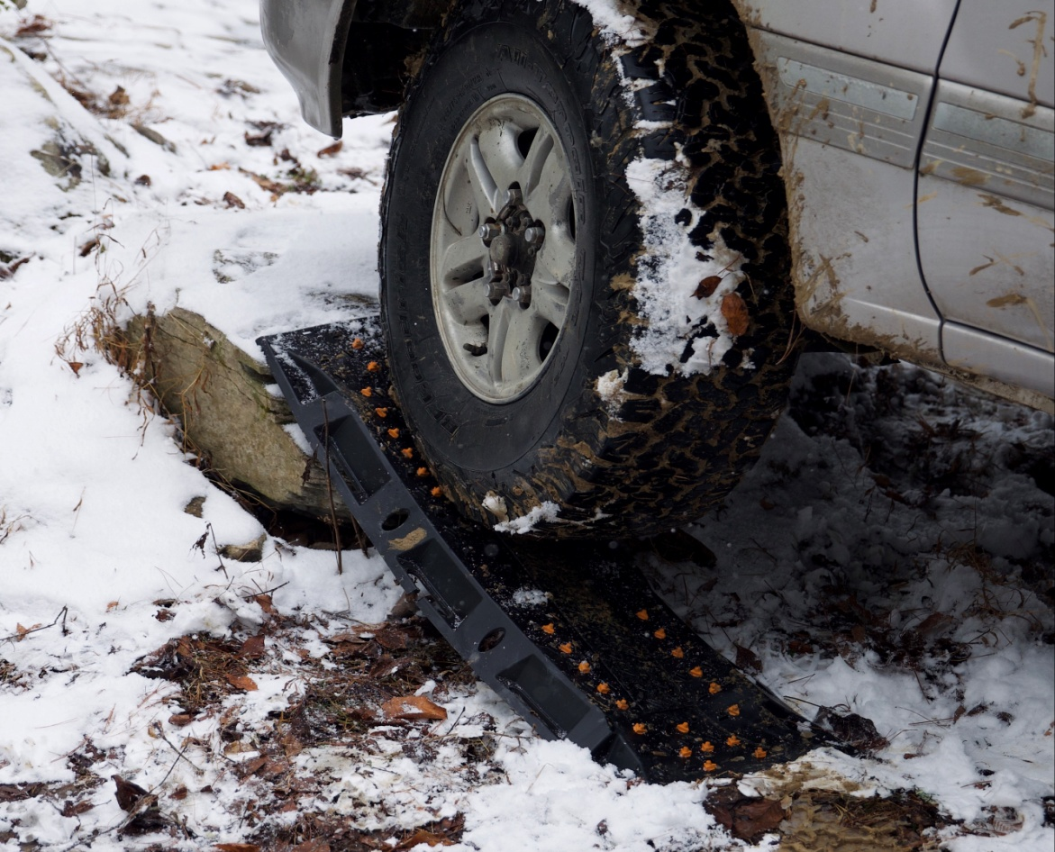
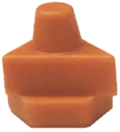
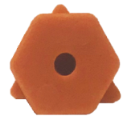
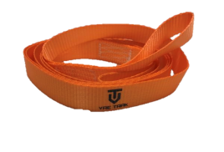
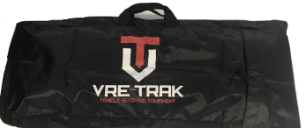
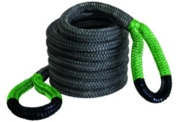
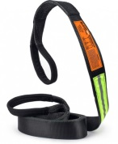
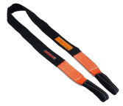
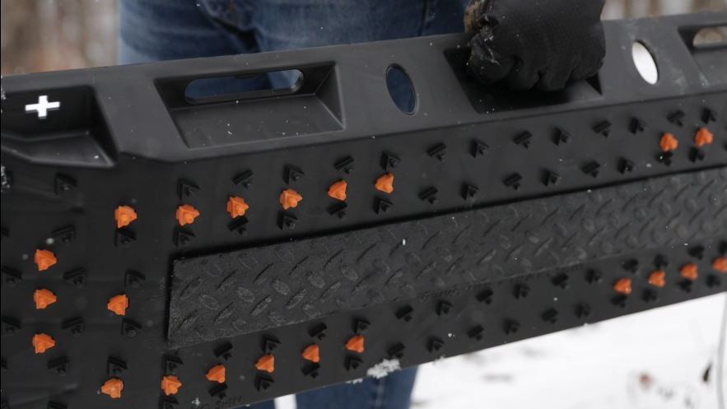
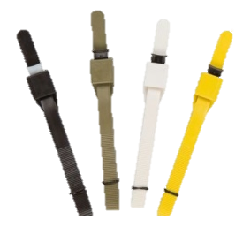
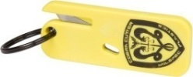
PRO SHOP
ACCESSORIES (SOLD SEPARATELY)
VRE-TRAK provides needed traction by insertion under tires for vehicles stuck in the mud, sand or snow! They also nest together for easy storage with handles & built-in storage box. Super Tough; with the ability handle 35k+ pound vehicles. VRE-TRAKs can also be linked together, end to end to create instant roads in adverse off-road conditions or side by side using Xtreme Zip Ties. Stakes can be used to avoid slippage. New Steel VRE-Bridge Insert (sold separately) can also help span gaps in rock or uneven terrain, supporting the vehicle to aid recovery with heavy vehicles.
VRE-TRAKs are Virtually Unbreakable; Reinforced UV-Resistant Polymer Resin can handle the Heaviest Vehicles and provide Needed Traction for Vehicle Recovery.
VT PRO-GRIPS
VRE-BRIDGE; STEEL INSERT
V-LEAD 8’
VRE-BAG
VR-TOW Jumbo 20-foot
Gator-Jaw PRO
Synthetic Shackle
Black Op Tow Strap
10-Foot Tree Hugger™
NEXT
LEVEL
Cobra Cutter™
XTREME Zip Ties™
Super Heavy Duty 10”
NYLON Stakes
VRE-TRAK.COM
Phone: 800-525-9878 I VRE-TRAK.COM

Slide 2
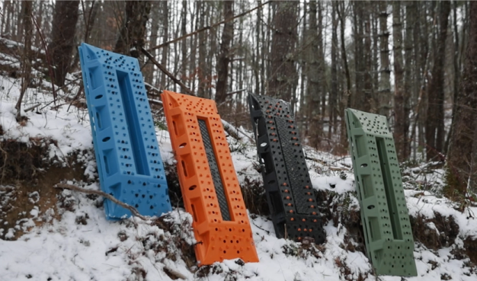
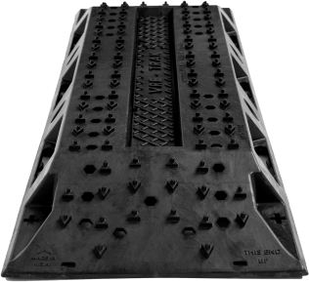
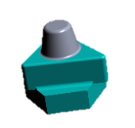
THE VRE-TRAK
VRE-TRAK FEATURES
ADVANTAGE
Dimensions
Overall Length: 42 Inches
Overall Width: 14 Inches
Overall Height: 3.4 Inches
Stack Height (2): 4.2 Inches
Part Weight (Ea): 6.1 lbs
VTS TREAD Design
The VTS Treads were designed to exceed the normal standard when it comes to maximum traction.
VTS Storage locker
Designed to store VTS accessories and tools & also functions to accept steel bridge insert.
VRE-BRIDGE INSERTS are welded ,carbon steel coated with cross-linked polyurethane and weigh 11 lbs. They are 26’’ in length and are designed to fit and lock into the VRE-TRAK storage compartment to provide bridging capability in rocky or difficult terrain; making extraction easier- especially with heavy weight vehicles.
STD COLORS: ORANGE, BLACK, GREEN & BLUE
VT PRO-GRIP
VT PRO-GRIP treads are easy to add for extra grip in extreme conditions and contrasting colors.
VT PRO-TREADS can be inserted into any hexagon hole on VRE-TRAK Boards to provide additional traction points or if some treads become worn down over time. Any areas with worn treads can be filled in by inserting VT PRO-TREADS into hexagon holes and locking in from the bottom with stainless steel hardware. Available in Black or Orange in packs of 8 or 20 pieces.
Bridging, linking & Mounting
Link multiple VRE-TRAKS together for recovery, mounting and bridging with welded steel insert (sold separately)
BUILT FOR Extreme Weight
VTS understructure is built for maximum structural integrity and will flex under heavy load.
Built-In Toolbox for your Leash, Stakes, Zip Ties and other small tools. One lid with attachment thumbscrews included per pair for the top VRE in the stack.
super tough 10’’ NYLON stakes
Nylon Stakes Designed to insert into VRE-TRAK “+” Holes to prevent slippage in mud or snow.
Back Side Shovel is a life saver when you have to dig out of a sticky situation. Flip the VRE-TRAK over, use either end of the ramp so you can remove debris away from your tire.
Ergonomic Handles
Six integrated handles provides multiple grab and control points.
BUILT FOR Extreme Weight
VRE-TRAK understructure is built for maximum structural integrity and will flex under heavy load.
VTS Ramp Design
Engineered with ramps on both sides for optimum vehicle recovery.
Phone: 800-525-9878 I VRE-TRAK.COM

